Slide 1
Advanced Computer Architecture
Branch Prediction
Notes:
Review today, not so fast in future

Slide 2
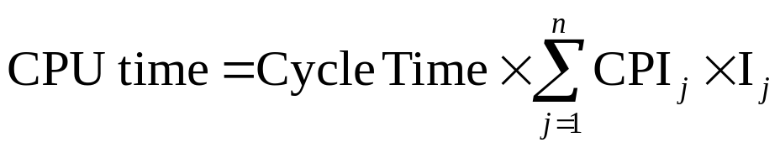
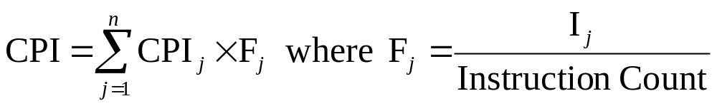
Cycles Per Instructions
“Average Cycles per Instruction”
CPI = (CPU Time * Clock Rate) / Instruction Count
  = Cycles / Instruction Count
“Instruction Frequency”

Slide 3
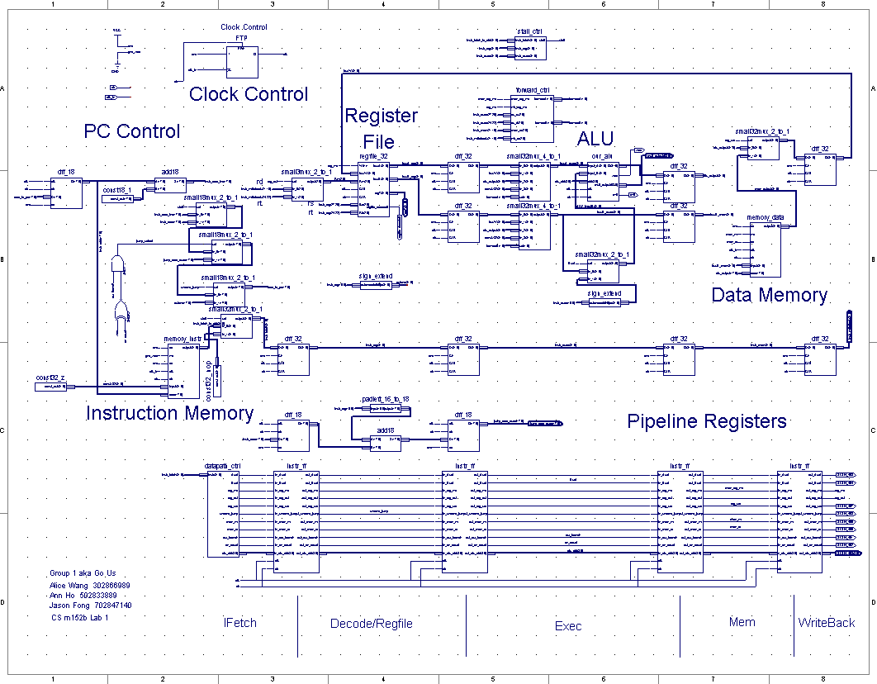
Typical Load/Store Processor
IF/ID
ID/EX
EX/MEM
MEM/WB
PC Control
Register
File
ALU
Data Memory
Instruction Memory
Notes:
alice

Slide 4

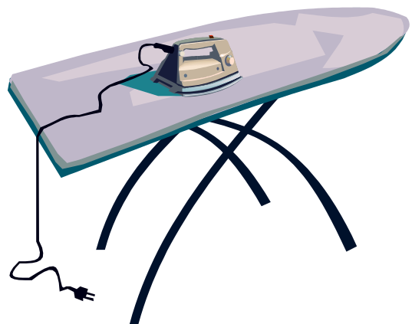

Pipelining Laundry
30 minutes
35 minutes
35 minutes
35 minutes
25 minutes
~53 min/set
3X Increase in
Productivity!!!
With large number of sets, the each
load takes average of ~35 min to wash
Three sets of Clean Clothes in 2 hours 40 minutes

Slide 5
Introducing Problems
Hazards prevent next instruction from executing during its designated clock cycle
  Structural hazards: HW cannot support this combination of instructions (single person to dry and iron clothes simultaneously)
  Data hazards: Instruction depends on result of prior instruction still in the pipeline (missing sock – needs both before putting them away)
  Control hazards: Caused by delay between the fetching of instructions and decisions about changes in control flow (Er…branch & jump)

Slide 6
Pipelined MIPS Processor
Temporal parallelism
Divide single-cycle processor into 5 stages:
  Fetch
  Decode
  Execute
  Memory
  Writeback
Add pipeline registers between stages

Slide 7
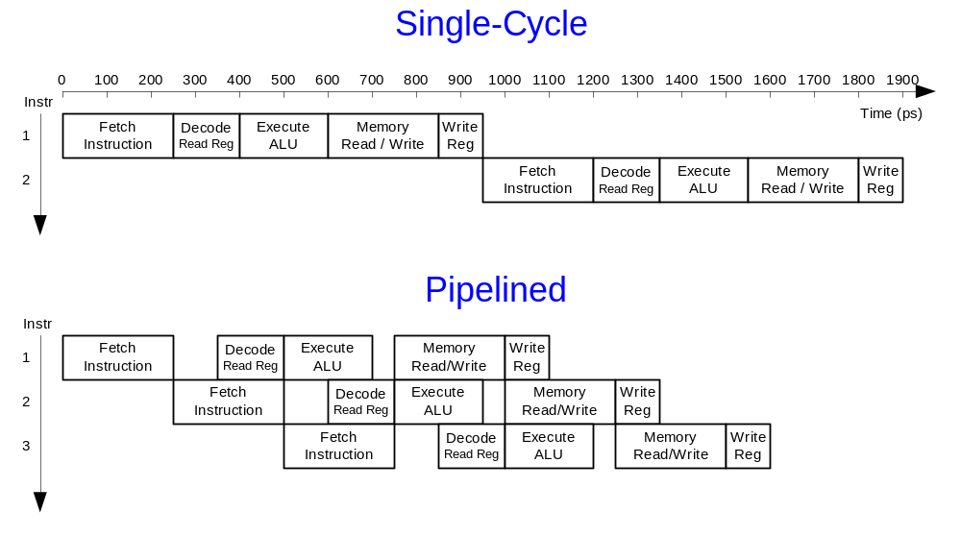
Single-Cycle vs. Pipelined

Slide 8
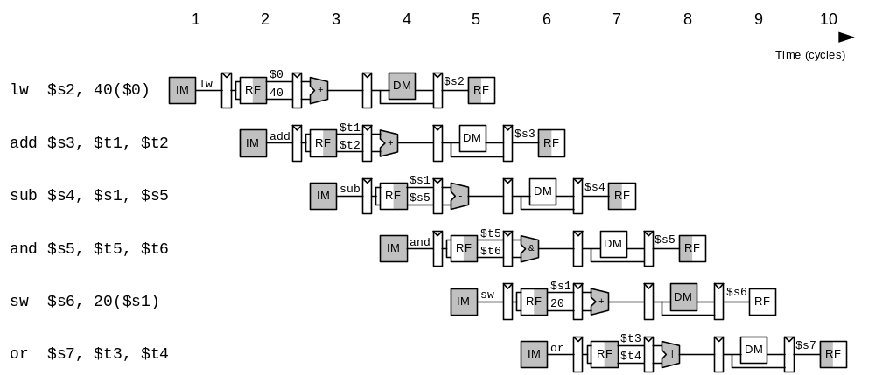
Pipelined Processor Abstraction

Slide 9
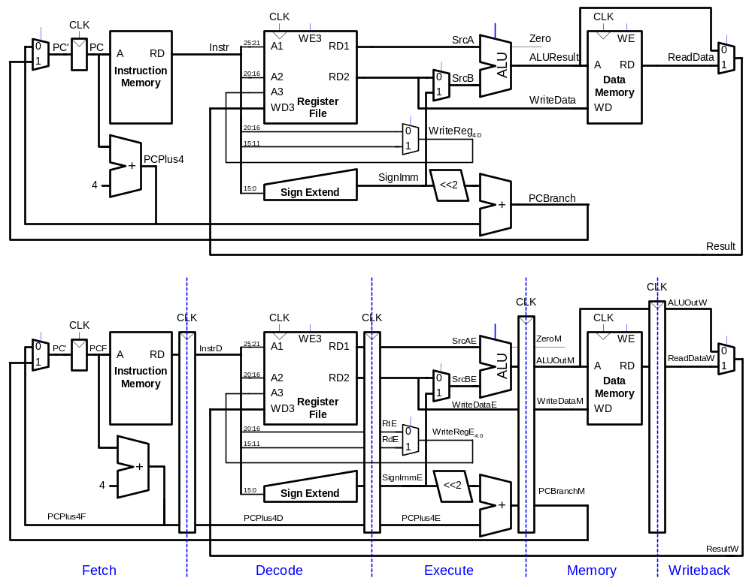
Single-Cycle & Pipelined Datapath

Slide 10
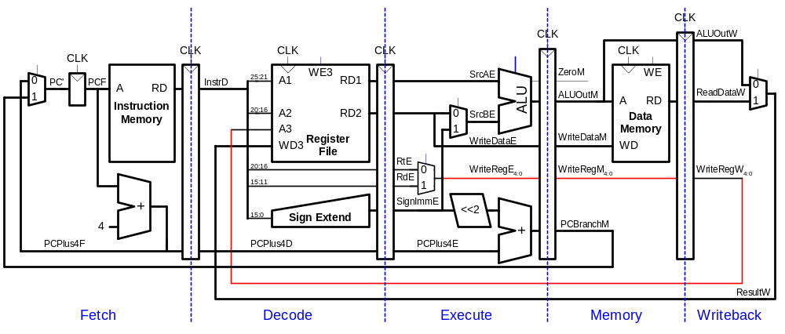
Corrected Pipelined Datapath
WriteReg must arrive at same time as Result

Slide 11
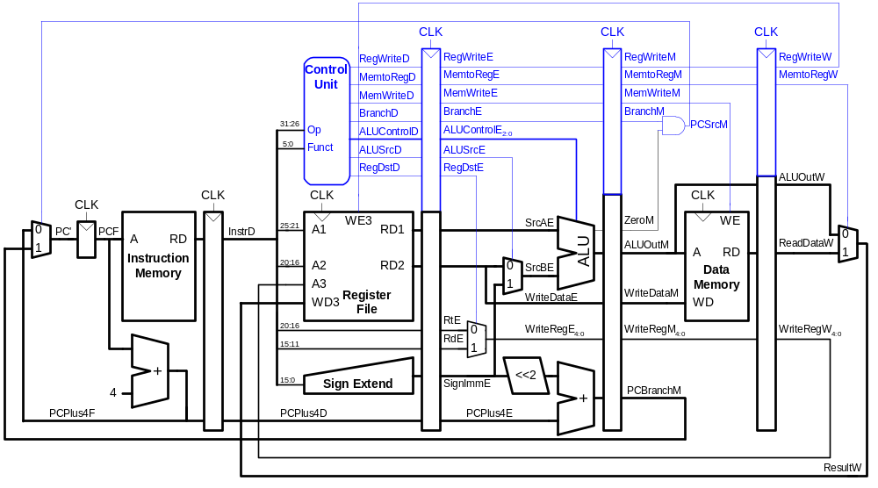
Pipelined Processor Control
Same control unit as single-cycle processor
Control delayed to proper pipeline stage

Slide 12
Pipeline Hazards
When an instruction depends on result from instruction that hasn’t completed
Types:
  Data hazard: register value not yet written back to register file
  Control hazard: next instruction not decided yet (caused by branches)

Slide 13
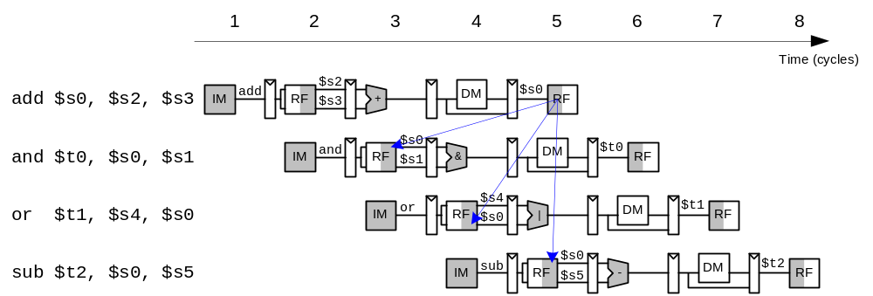
Data Hazard

Slide 14
Handling Data Hazards
Insert nops in code at compile time
Rearrange code at compile time
Forward data at run time
Stall the processor at run time

Slide 15
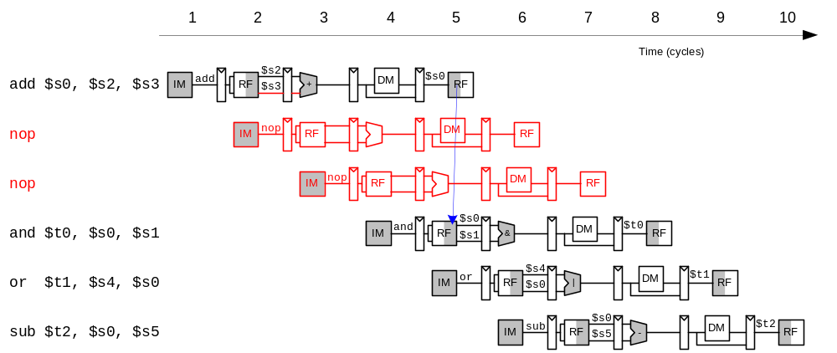
Compile-Time Hazard Elimination
Insert enough nops for result to be ready
Or move independent useful instructions forward

Slide 16
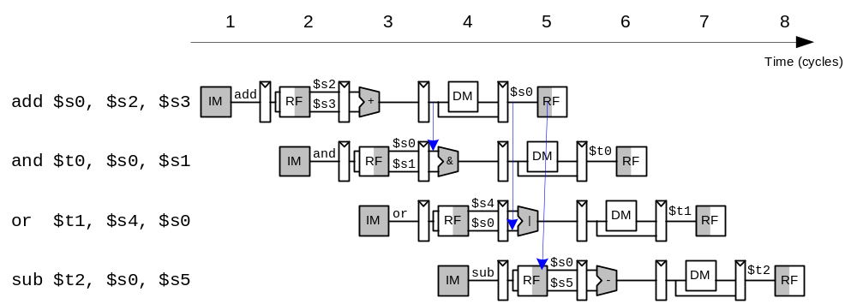
Data Forwarding

Slide 17
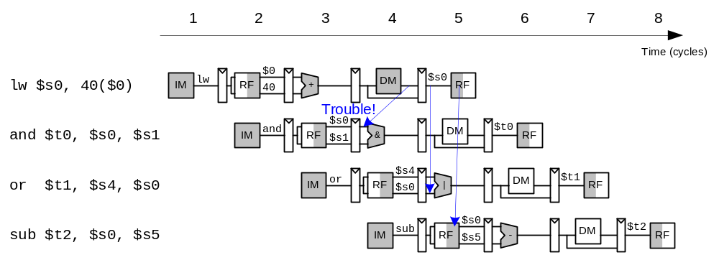
Stalling

Slide 18
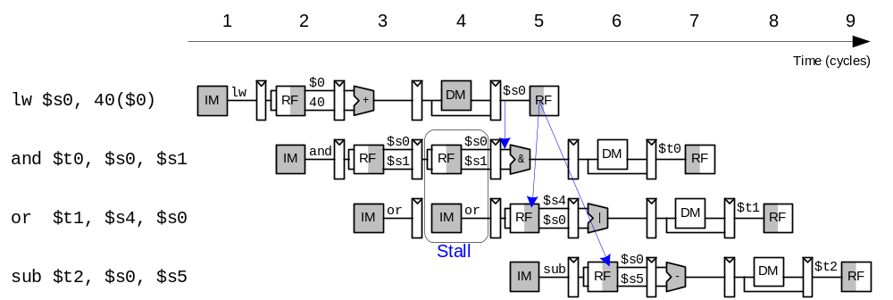
Stalling

Slide 19
Control Hazards
beq:
  branch not determined until 4th stage of pipeline
  Instructions after branch fetched before branch occurs
  These instructions must be flushed if branch happens
Branch misprediction penalty
  number of instruction flushed when branch is taken
  May be reduced by determining branch earlier

Slide 20
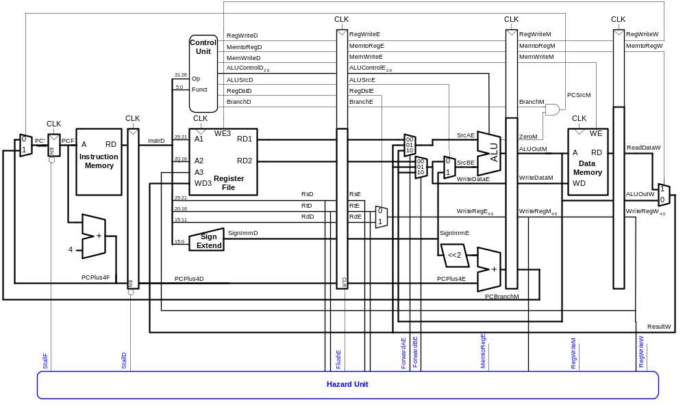
Control Hazards: Original Pipeline

Slide 21
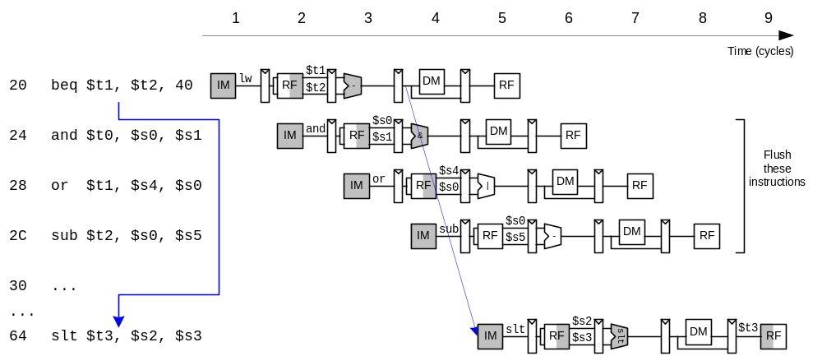
Control Hazards

Slide 22
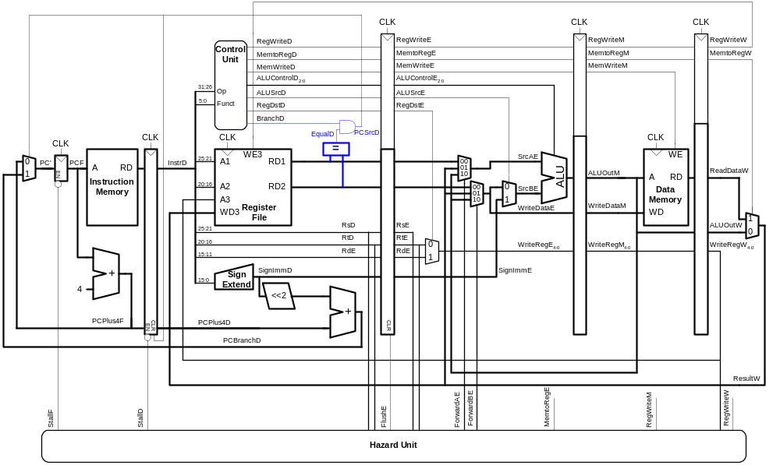
Early Branch Resolution
Introduced another data hazard in Decode stage

Slide 23
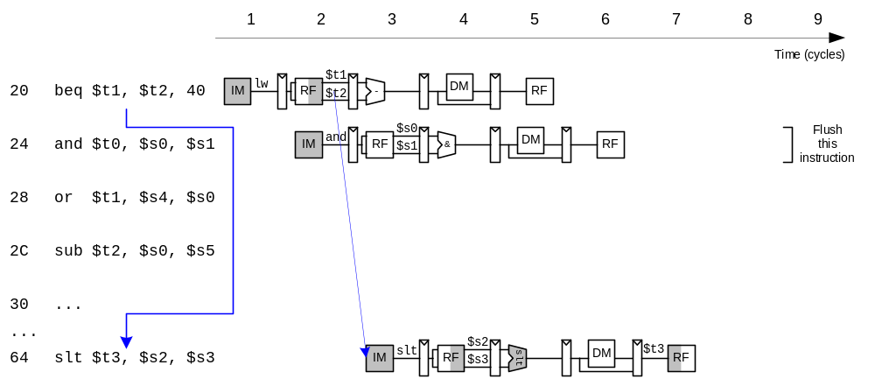
Early Branch Resolution

Slide 24
Data Hazards
Read After Write (RAW)
  Instr₂ tries to read operand before Instr₁ writes it
  Caused by a “Dependence” in compiler term
Write After Read (WAR)
  Instr₂ writes operand before Instr₁ reads it
  Called an “anti-dependence” in compiler term
  Sw R2, 0(R1) IF ID EX MEM1 MEM2 WB
  Add R2, R3, R4 IF ID EX WB
Write After Write (WAW)
  Instr₂ writes operand before Instr₁ writes it
  “Output dependence” in compiler term
  Lw R1, 0(R2) IF ID EX MEM1 MEM2 WB
  Add R1, R2, R3 IF ID EX WB
WAR and WAW in more complex systems

Slide 25
Branch Hazard Alternatives
Stall until branch direction is clear
Predict Branch Not Taken
  Execute successor instructions in sequence
  “Squash” instructions in pipeline if branch actually taken
  Advantage of late pipeline state update
  47% DLX branches not taken on average
  PC+4 already calculated, so use it to get next instr
Predict Branch Taken
  53% DLX branches taken on average
  DLX still incurs 1 cycle branch penalty
  Other machines: branch target known before outcome

Slide 26
Branch Hazard Alternatives
Delayed Branch
  Define branch to take place AFTER a following instruction (Fill in Branch Delay Slot)
  branch instruction
  sequential successor₁
  sequential successor₂
  ........
  sequential successor_{n}
  branch target if taken
  1 slot delay allows proper decision and branch target address in 5 stage pipeline
Branch delay of length n

Slide 27
Evaluating Branch Alternatives
Scheduling Branch CPI speedup v. speedup v. scheme penalty unpipelined stall
Stall pipeline 3 1.42 3.5 1.0
Predict taken 1 1.14 4.4 1.26
Predict not taken 1 1.09 4.5 1.29
Delayed branch 0.5 1.07 4.6 1.31

Slide 28
Solution to Hazards
Structural Hazards
  Delaying HW Dependent Instruction
  Increase Resources (i.e. dual port memory)
Data Hazards
  Data Forwarding
  Software Scheduling
Control Hazards
  Pipeline Stalling
  Predict and Flush
  Fill Delay Slots with Previous Instructions

Slide 29
Typical Pipeline
Example: MIPS R4000
integer unit
ex
FP/int Multiply
IF
ID
m1
m2
m3
m4
m5
m6
m7
MEM
WB
FP adder
a1
a2
a3
a4
FP/int divider
Div (lat = 25, Init inv=25)

Slide 30
Prediction
Easy to fetch multiple (consecutive) instructions per cycle
  Essentially speculating on sequential flow
Jump: unconditional change of control flow
  Always taken
Branch: conditional change of control flow
  Taken typically ~50% of the time in applications
    Backward: 30% of the Branch → 80% taken = ~24%
    Forward: 70% of the Branch → 40% taken = ~28%

Slide 31
Branch Prediction Schemes
Static Branch Prediction
Dynamic Branch Prediction
  1-bit Branch-Prediction Buffer
  2-bit Branch-Prediction Buffer
  Correlating Branch Prediction Buffer
  Tournament Branch Predictor
Branch Target Buffer

Slide 32
Static Branch Prediction
Execution profiling
  Very accurate if Actually take time to Profile
  Incovenient
Heuristics based on nesting and coding
  Simple heuristics are very inaccurate
Programmer supplied hints...
  Inconvenient and potentially inaccurate

Slide 33
Dynamic Branch Prediction
Performance = ƒ(accuracy, cost of mis-prediction)
1-bit Branch History Table
  Bitmap for Lower bits of PC address
  Says whether or not branch taken last time
  If Inst is Branch, predict and update the table
Problem
  1-bit BHT will cause 2 mis-predictions for Loops
    First time through the loop, it predicts exit instead loop
    End of loop case, it predicts loops instead of exit
  Avg is 9 iterations before exit
    Only 80% accuracy even if loop 90% of the time

Slide 34
N-bit Dynamic Branch Prediction
N-bit scheme where change prediction only if get misprediction N-times:
T
NT
Predict Taken
Predict Taken
T
T
NT
NT
Predict Not
Taken
Predict Not
Taken
T
NT
2-bit Scheme: Saturates the prediction up to 2 times

Slide 35
Correlating Branches
(2,2) predictor
  2-bit global: indicates the behavior of the last two branches
  2-bit local (2-bit Dynamic Branch Prediction)
Branch History Table
  Global branch history is used to choose one of four history bitmap table
  Predicts the branch behavior then updates only the selected bitmap table
  Branch address (4 bits)
Prediction
2-bit recent global
branch history
(01 = not taken then taken)

Slide 36
Accuracy of Different Schemes
20%
18%
4096 Entries 2-bit BHT
Unlimited Entries 2-bit BHT
1024 Entries (2,2) BHT
18%
16%
14%
12%
11%
Frequency of Mispredictions
Frequency of Mispredictions
10%
8%
6%
6%
6%
6%
5%
5%
4%
4%
2%
1%
1%
0%
0%
nasa7
matrix300
tomcatv
doducd
spice
fpppp
gcc
espresso
eqntott
li

Slide 37
Tournament Branch Predictors
Correlating Predictor
  2-bit predictor failed on important branches
  Better results by also using global information
Tournament Predictors
  1 Predictor based on global information
  1 Predictor based on local information
  Use the predictor that guesses better
addr
Predictor A
Predictor B

Slide 38
Branch Prediction Accuracy
99%
tomcatv
99%
100%
95%
doduc
84%
97%
86%
fpppp
82%
Profile-based
98%
2-bit dynmic
88%
Tournament
li
77%
98%
86%
espresso
82%
96%
88%
gcc
70%
94%
0%
20%
40%
60%
80%
100%

Slide 39
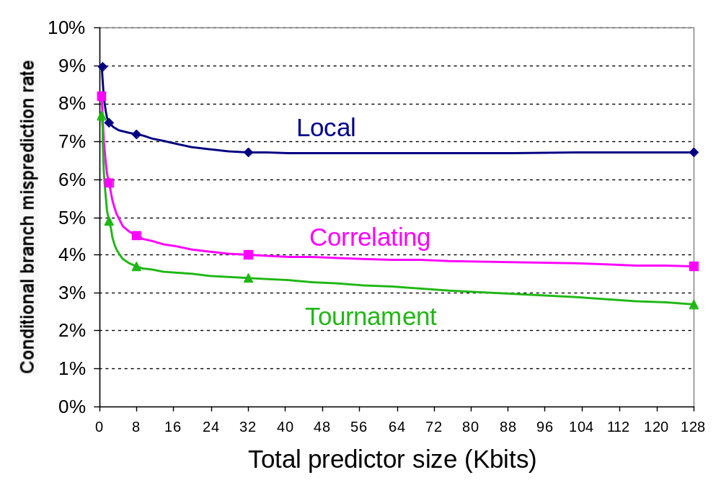
Accuracy versus Size

Slide 40
Branch Target Buffer
Branch Target Buffer (BTB): Address of branch index to get prediction AND branch address (if taken)
  Note: must check for branch match now, since can’t use wrong branch address
Branch PC
Predicted PC
PC of instruction
FETCH
=?
Yes: instruction is branch and use predicted PC as next PC
Extra
prediction state
bits
No: branch not
predicted, proceed normally
(Next PC = PC+4)

Slide 41
Zero Cycle Jump
What really has to be done at runtime?
  Once an instruction has been detected as a jump or JAL, we might recode it in the internal cache.
  Very limited form of dynamic compilation?
Use of “Pre-decoded” instruction cache
  Called “branch folding” in the Bell-Labs CRISP processor.
  Original CRISP cache had two addresses and could thus fold a complete branch into the previous instruction
  Notice that JAL introduces a structural hazard on write
Internal Cache state:
and r3,r1,r5
A+4
and r3,r1,r5
addi r2,r3,#4
sub r4,r2,r1
jal doit
subi r1,r1,#1
A:
N
addi r2,r3,#4
A+8
N
sub r4,r2,r1
sub r4,r2,r1
doit
L
---
---
--
subi r1,r1,#1
A+20
N

Slide 42
Dynamic Branch Prediction Summary
Prediction becoming important part of scalar execution
Branch History Table
  2 bits for loop accuracy
Correlation
  Recently executed branches correlated with next branch.
  Either different branches
  Or different executions of same branches
Tournament Predictor
  More resources to competitive solutions and pick between them
Branch Target Buffer
  Branch address & prediction

Slide 43
Basic Compiler Techniques for Exposing
  Basic pipeline scheduling and loop unrolling
    To keep a pipeline full, parallelism among instructions must be exploited by finding sequences of unrelated instructions that can be overlapped in the pipeline.
    A compiler’s ability to perform such kind of scheduling depends on both the amount of ILP available in the program and on the latencies of the functional units in the pipeline.
    To avoid a pipeline stall, a dependent instruction must be separated from the source instruction by a distance in clock cycles equal to the pipeline latency of that source instruction..

Slide 44
Scheduling and Loop Unrolling
  Basic assumptions:
    The latencies of the FP unit
      Inst. producing result Inst. Using result Latency
      FP ALU op Another FP ALU op 3
      FP ALU op Store double 2
      Load double FP ALU op 1
      Load double Store double 0
    The branch delay of the pipeline implementation is 1 delay slot.
    The functional units are fully pipelined or replicated such that no structural hazards can occur

Slide 45
Loop Unrolling by Compilers
  Example:
        for (j=1, j<= 1000, j++)
    x[j]=x[j]+s;
    Assume R1 initially holds the highest address of the first element and 8(R2) holds the last element.
      Loop: L.D F0, 0(R1)
      ADD.D F4, F0, F2
      S.D F4, 0(R1)
      DADDUI R1, R1, #-8
      BNE R1, R2,Loop
      Performance of scheduled code with loop unrolling.

Slide 46
Performance of Unscheduled Code without Loop Unrolling
      Clock cycle issued
      Loop: L.D F0, 0(R1) 1
      stall 2
      ADD.D F4, F0, F2 3
      stall 4
      stall 5
      S.D F4, 0(R1) 6
      DADDUI R1, R1, #-8 7
      stall 8
      BNE R1, R2,Loop 9
      stall 10
  Need 10 cycles per result

Slide 47
Performance of Scheduled Code without Loop Unrolling
      Loop: L.D F0, 0(R1)
      DADDUI R1, R1, #-8
      ADD.D F4, F0, F2
      stall
      BNE R1, R2,Loop ; delay branch
      S.D F4, 8(R1)
  Need 6 cycles per result

Slide 48
Performance of Unscheduled Code with Loop Unrolling
Unroll the loop 4 iterations
      Loop: L.D F0, 0(R1)
      ADD.D F4, F0, F2
      S.D F4, 0(R1)
      L.D F6, -8(R1)
      ADD.D F8, F6, F2
      S.D F8, -8(R1)
      L.D F10, -16(R1)
      ADD.D F12, F10, F2
      S.D F12, -16(R1)
      L.D F14, -24(R1)
      ADD.D F16, F14, F2
      S.D F16, -24(R1)
      DADDUI R1, R1, #--32
      BNE R1, R1, Loop
  Needs 7 cycles per result

Slide 49
Performance of Scheduled Code with Loop Unrolling
      Loop: L.D F0, 0(R1)
      L.D F6, -8(R1)
      L.D F10, -16(R1)
      L.D F14, -24(R1)
      ADD.D F4, F0, F2
      ADD.D F8, F6, F2
      ADD.D F12, F10, F2
      ADD.D F16, F14, F2
      S.D F4, 0(R1)
      S.D F8, -8(R1) DADDUI R1, R1, #--32
      S.D F12, 16(R1)
      BNE R1, R1, Loop
      S.D F16, 8(R1)
    Need 3.5 cycles per result

